Slide 1
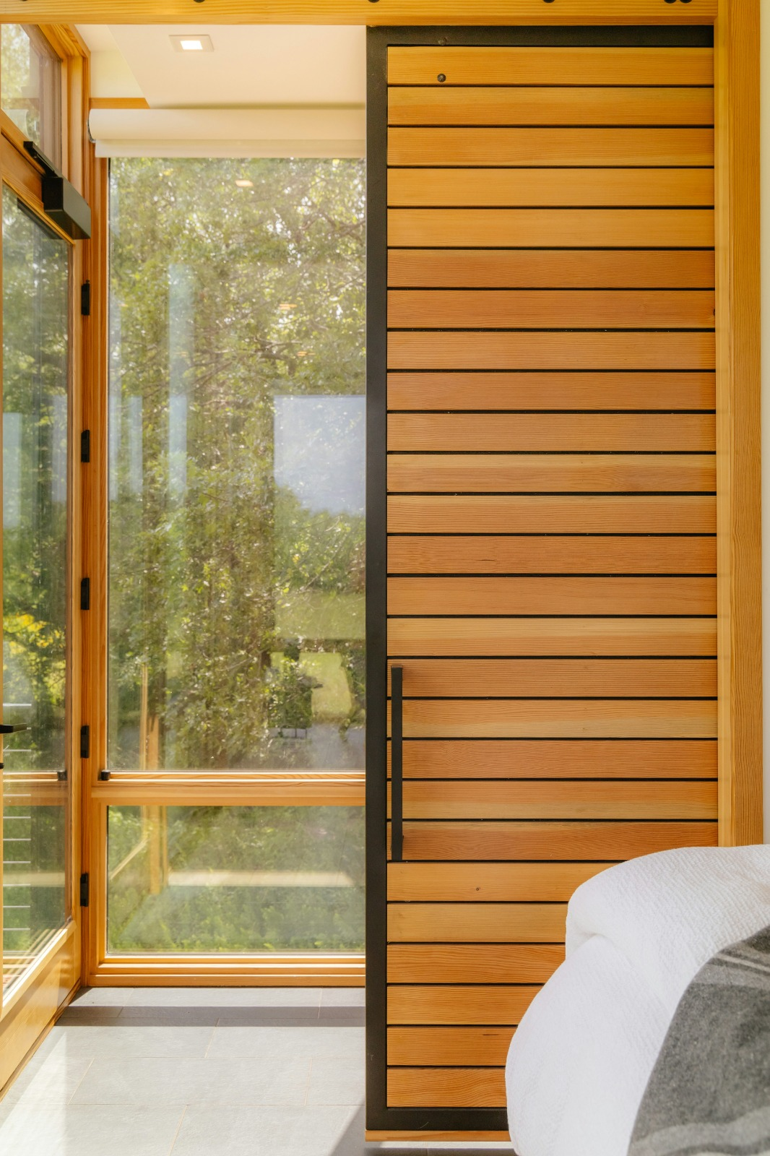
Aı color recommender
Irmak nur konukcu
Merve karadöl

Slide 2
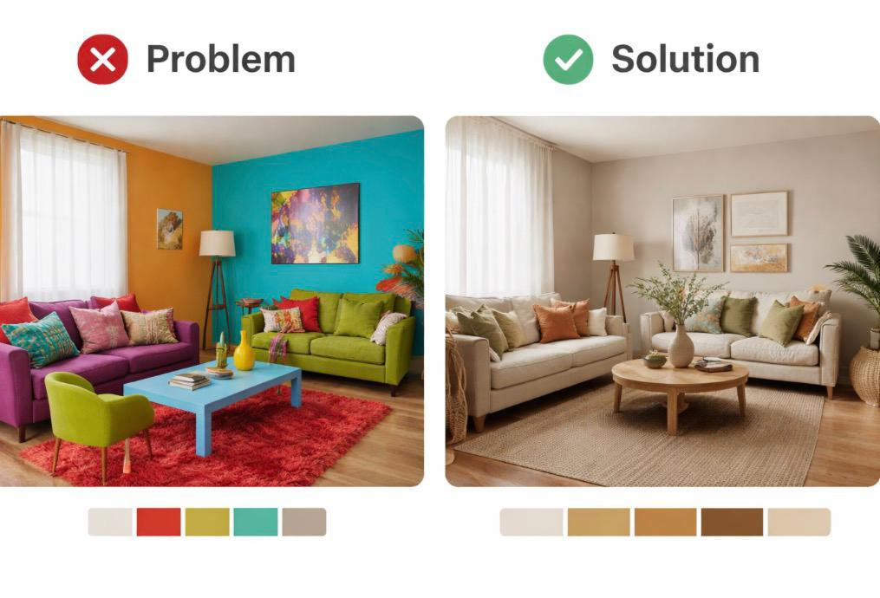
Problem and solutIon
❌ Problem
Difficulty in color harmony
Wrong decoration choices
Time and cost inefficiency
✅ Solution
Upload room photo
AI-based color analysis
Harmonious recommendations

Slide 3
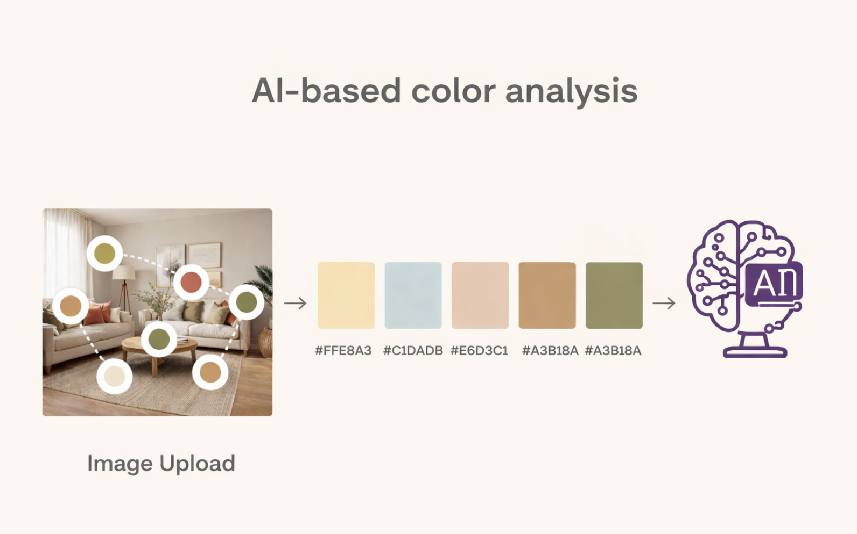
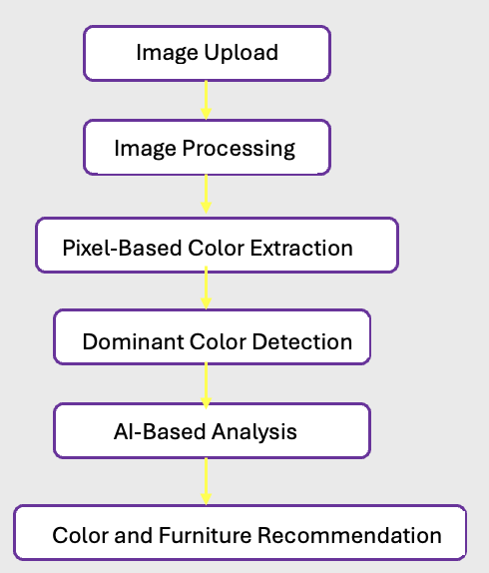
How ıt works
System workflow

Slide 4
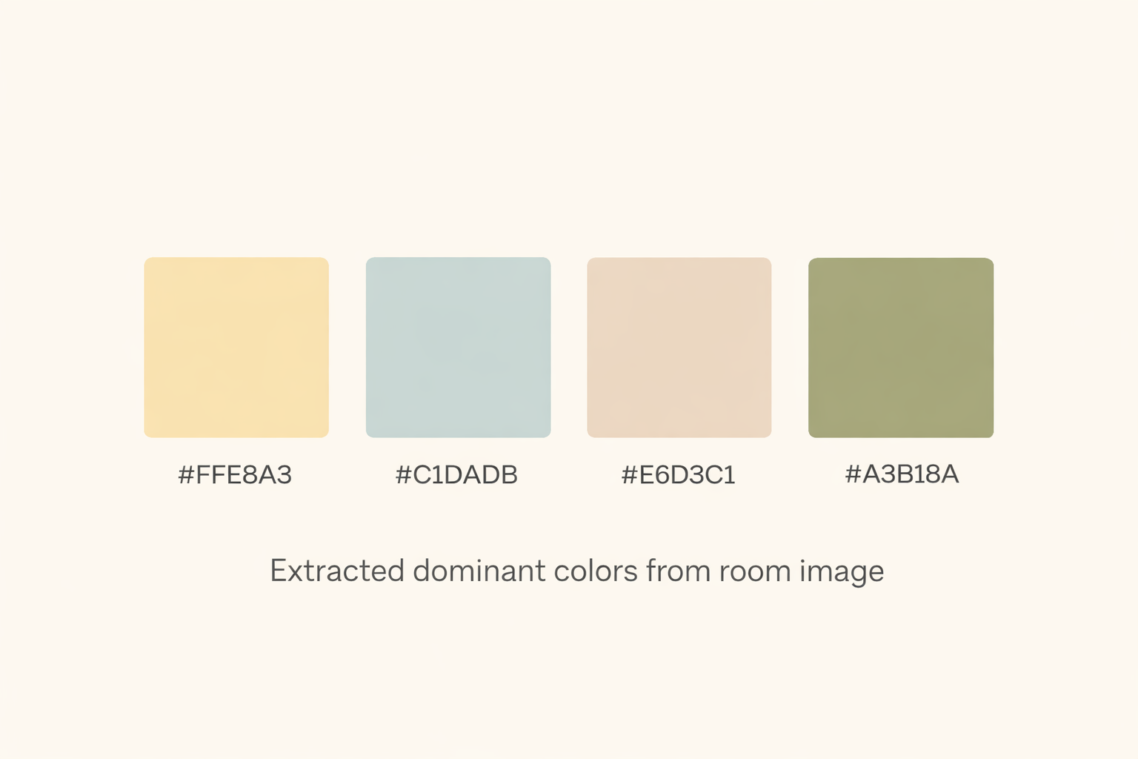
Algorıthm Implementatıon
image = Image.open(file.stream).convert("RGB") //Image processing
pixels = list(image.getdata()) // Color analysis in pixels
hex_colors = [
'#{:02x}{:02x}{:02x}'.format(r, g, b)
for r, g, b in pixels
] //Color values are extracted numerically
result = {
'analysis': analysis_text,
'dominant_colors': hex_colors[:5]
} // brings out the dominant color tones

Slide 5
Technologıes Used
Backend & AI
Python
Flask
Scikit-learn (K-Means)
NumPy
OpenCV
Frontend
HTML
CSS
JavaScript
Development Tools
Git & GitHub
VS Code

Slide 6
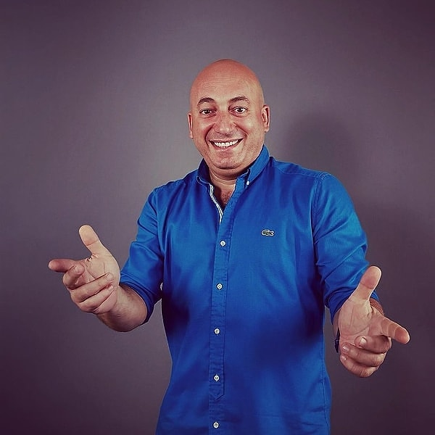
THANK YOU

